Slide 1
Pollinator Garden Plant List

Slide 2
Checklist – what’s in your garden?
Plant type | Number
Moonshine Yarrow (Achillea x ‘Moonshine’) | 7
Arizona milkweed (Asclepias angustifolia) | 12
Antelope horns milkweed (Asclepias asperula)
Giant sand milkweed (Asclepias erosa)
Pineneedle milkweed (Asclepias linaria) | 13
Desert milkweed (Asclepias subulata) | 2
Horsetail milkweed (Asclepias subverticillata)
Desert marigold (Baileya multiradiata)
Chocolate flower (Berlandiera lyrata) | 10
Baja fairy duster (Calliandra californica)
Pink fairy duster (Calliandra eriophylla)
Desert willow (Chilopsis linearis)
Damianita daisy (Chrysactinia mexicana)
Plant type | Number
Gregg’s mistflower (Conoclinium greggii) | 12
Yellow dalea (Dalea lutea)
Eastern Mojave buckwheat (Eriogonum fasciculatum)
Desert lavender (Hyptis emoryi)
Winterfat (Krascheninnikovia lanata) | 5
Blackfoot daisy (Melampodium leucanthum) | 9
Penstemon species (Penstemon spp.)
Autumn sage (Salvia greggii)
Mount Lemmon Marigold (Tagetes lemmonii) | 7
Yellow trumpet bush (Tecoma stans)
Angelita daisy (Tetraneuris acaulis)

Slide 3
Moonshine Yarrow Achillea x ‘Moonshine’

Slide 4
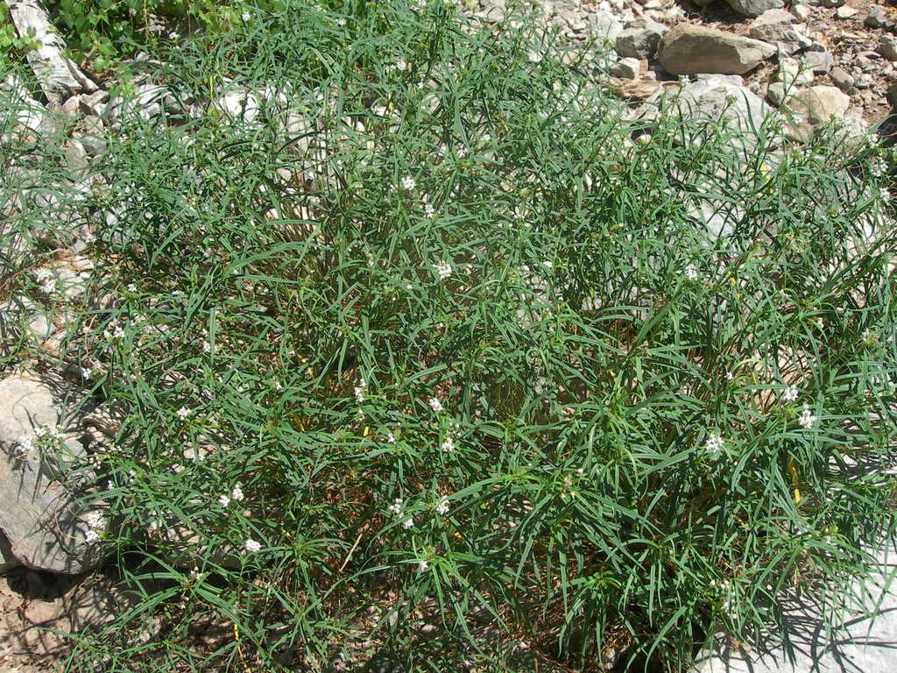
Arizona milkweed Asclepias angustifolia

Slide 5
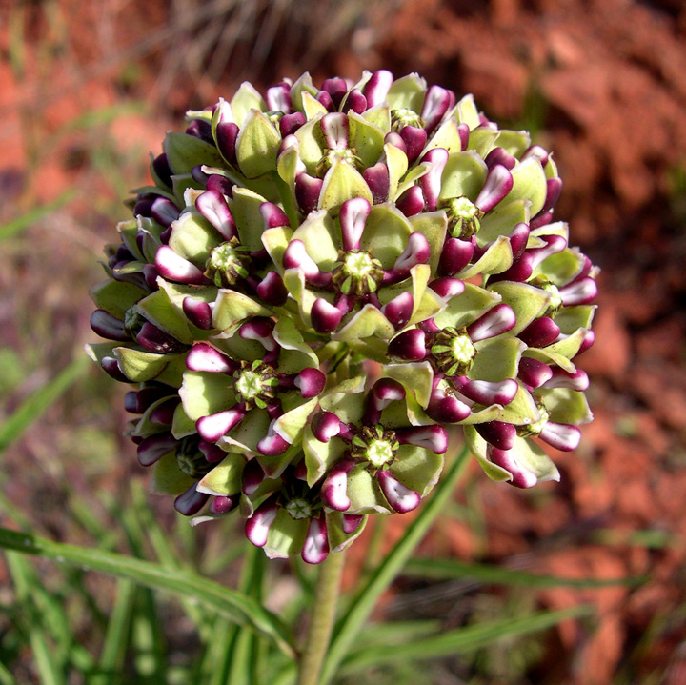
Antelope horns milkweed Asclepias asperula

Slide 6
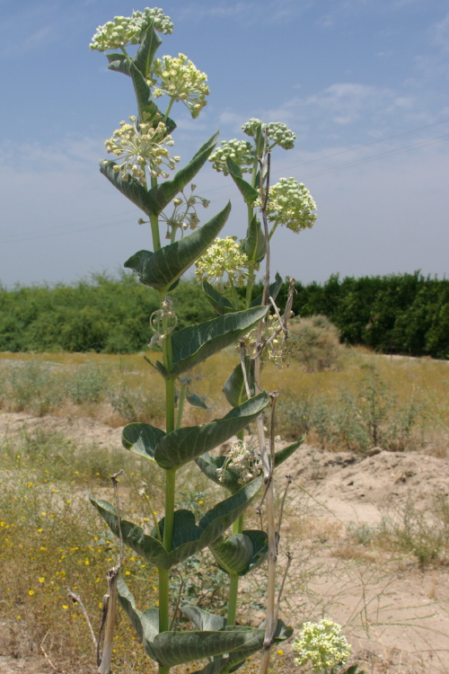
Giant sand milkweed Asclepias erosa

Slide 7
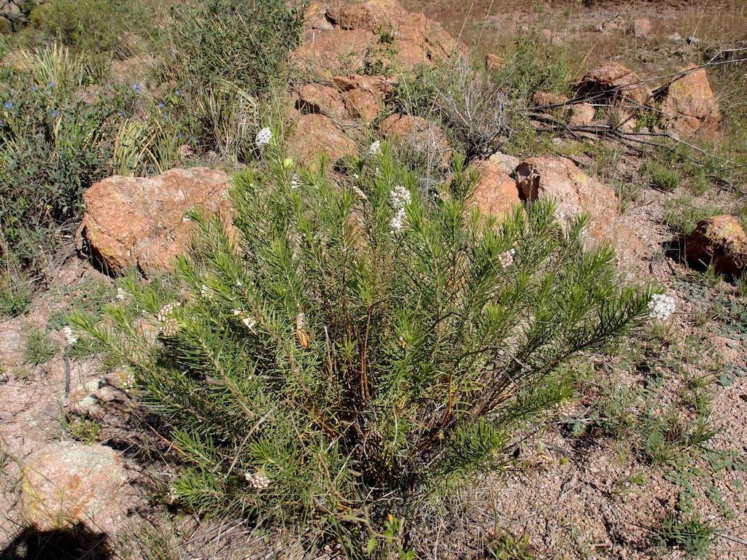
Pineneedle milkweed Asclepias linaria

Slide 8
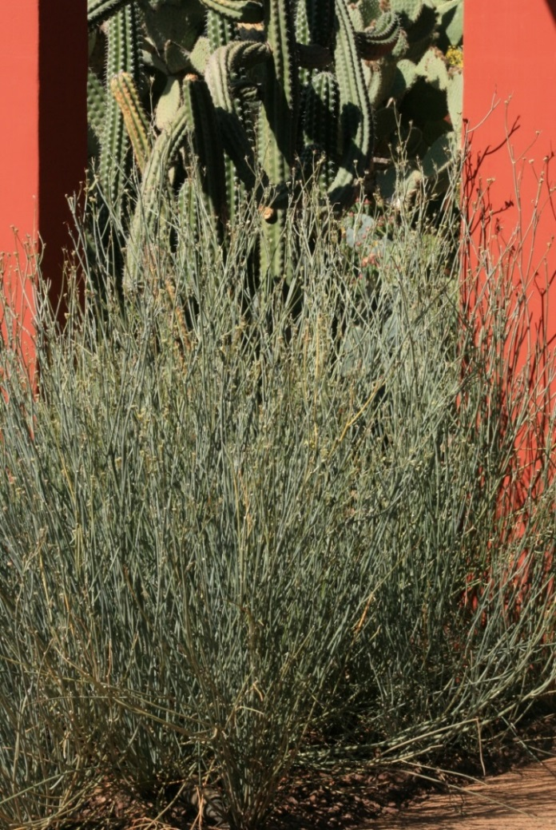
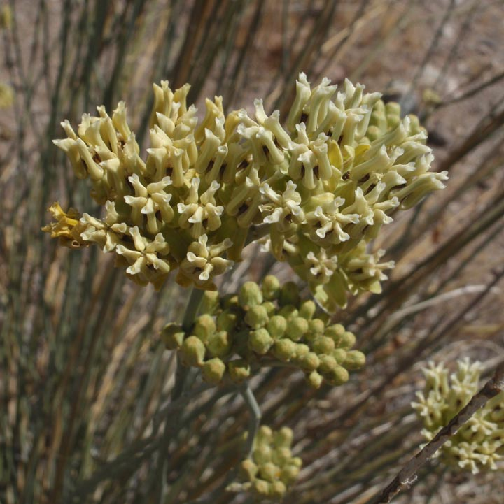
Desert milkweed Asclepias subulata

Slide 9
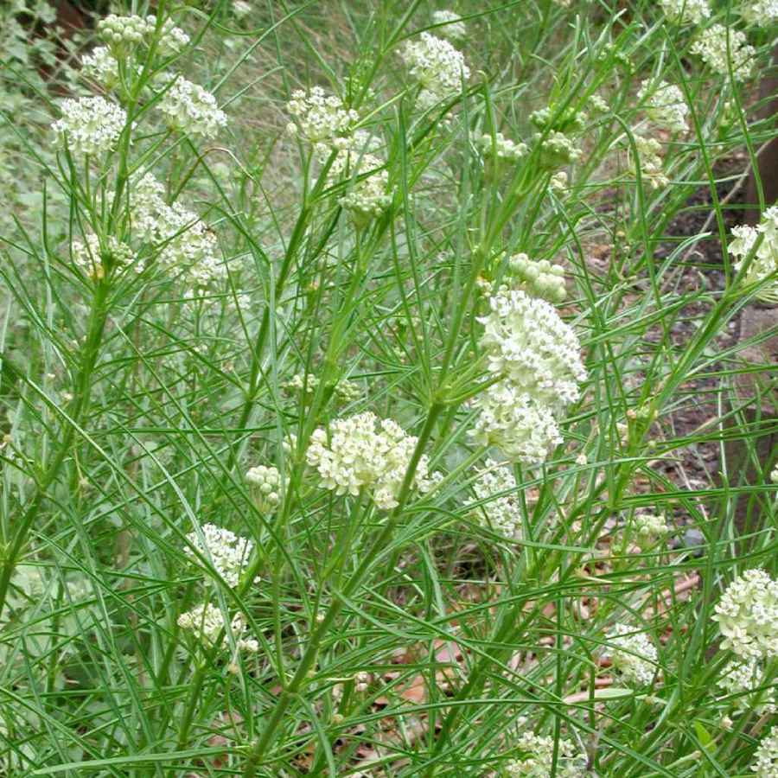
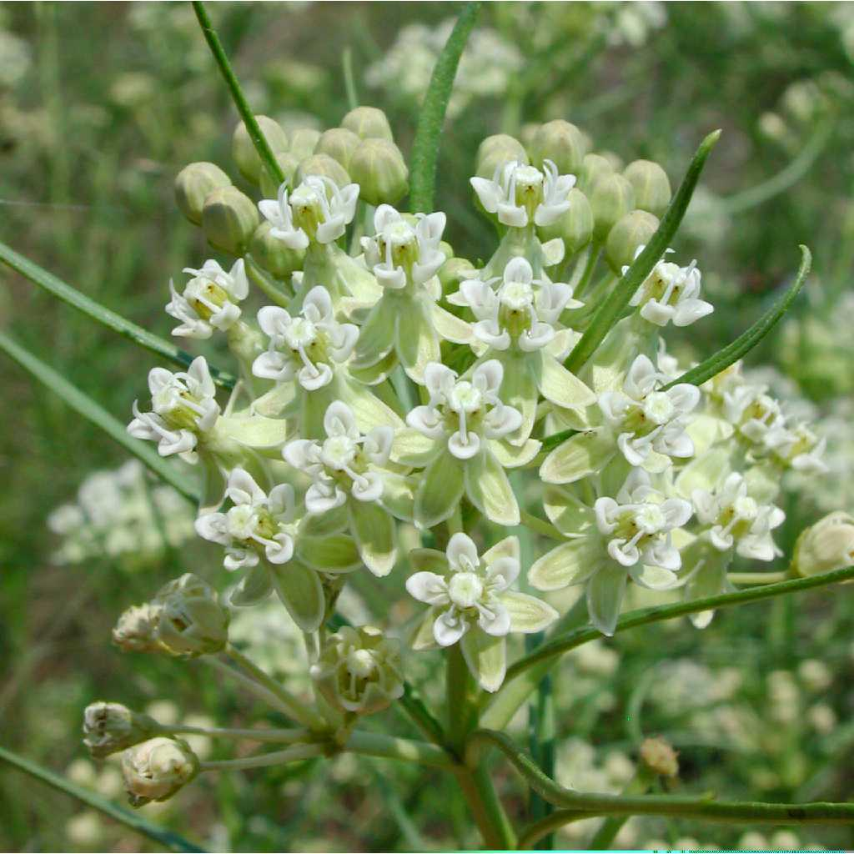
Horsetail milkweed Asclepias subverticillata

Slide 10
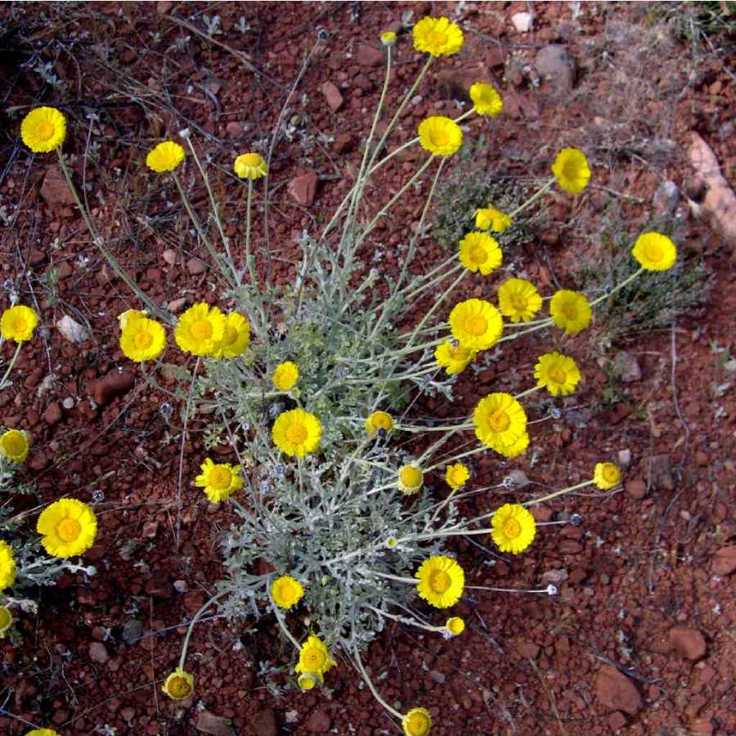
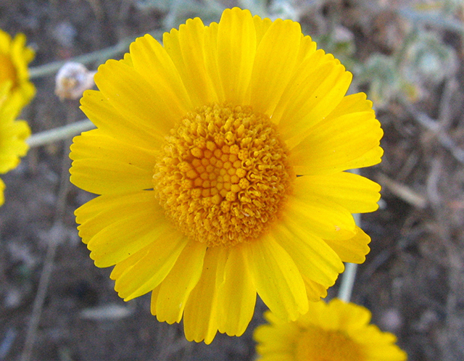
Desert marigold Baileya multiradiata

Slide 11
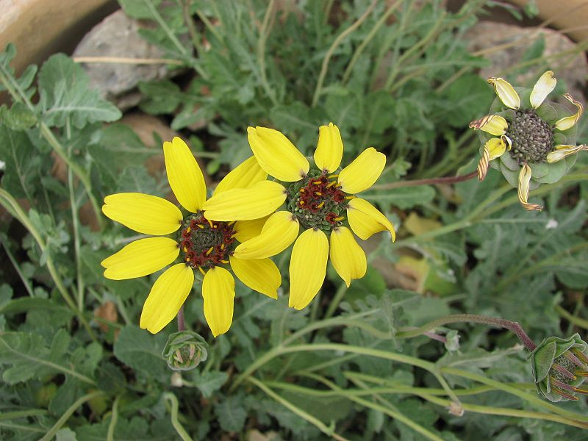
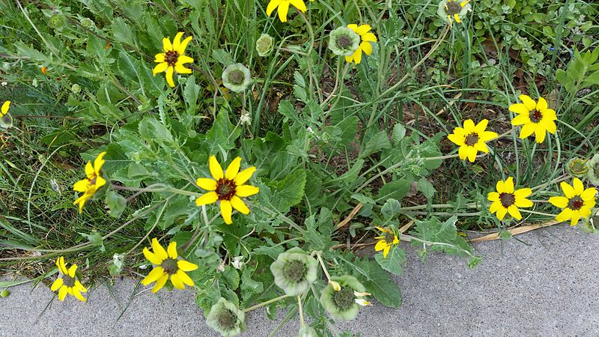
Chocolate flower Berlandiera lyrata

Slide 12
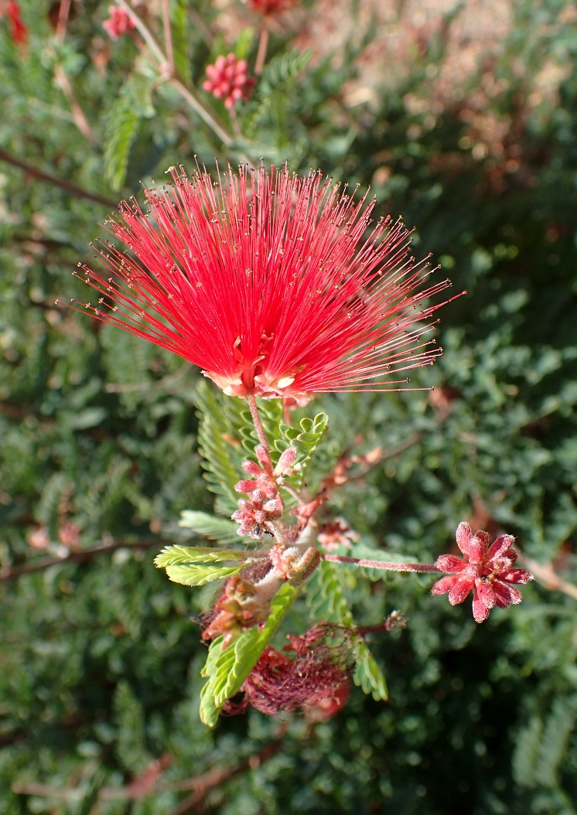
Baja Fairy Duster Calliandra californica

Slide 13
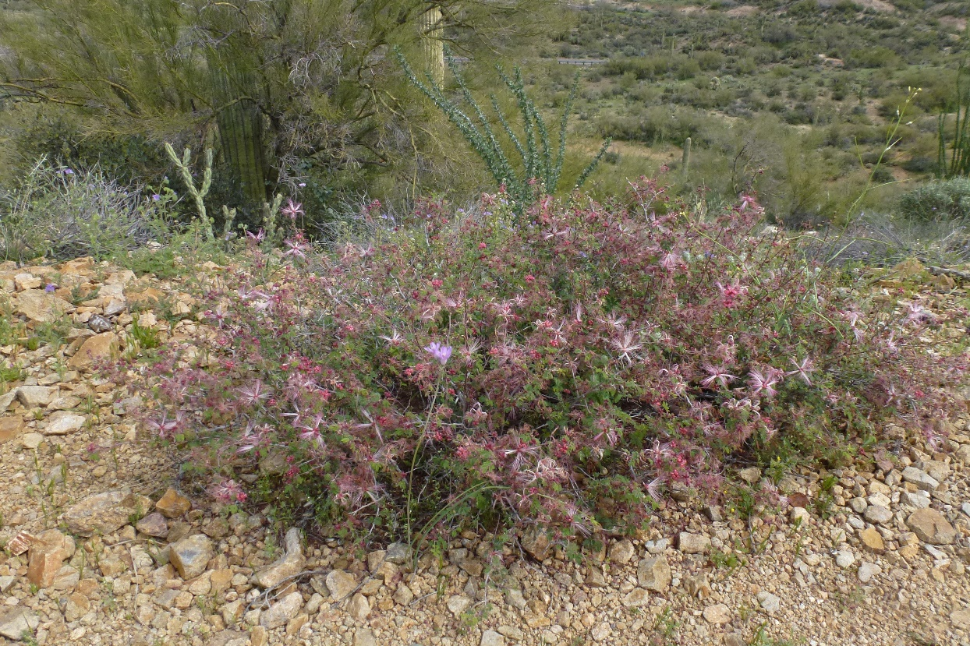
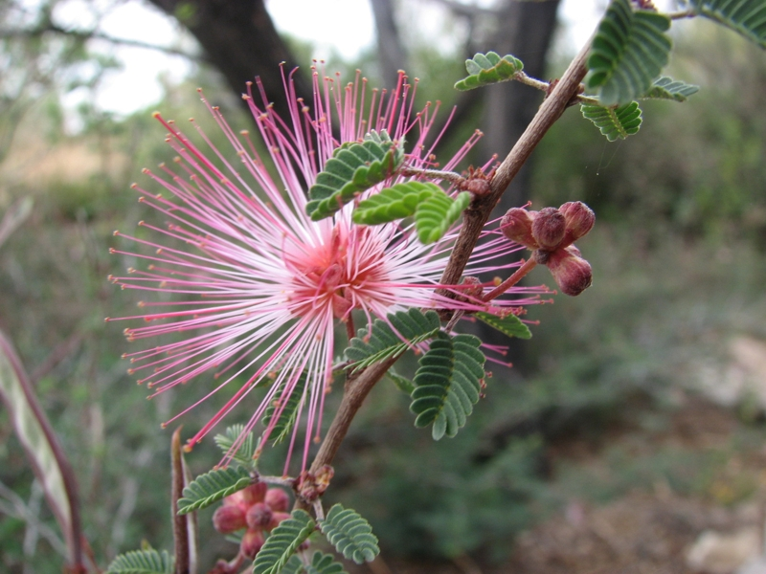
Pink Fairy Duster Calliandra eriophylla

Slide 14
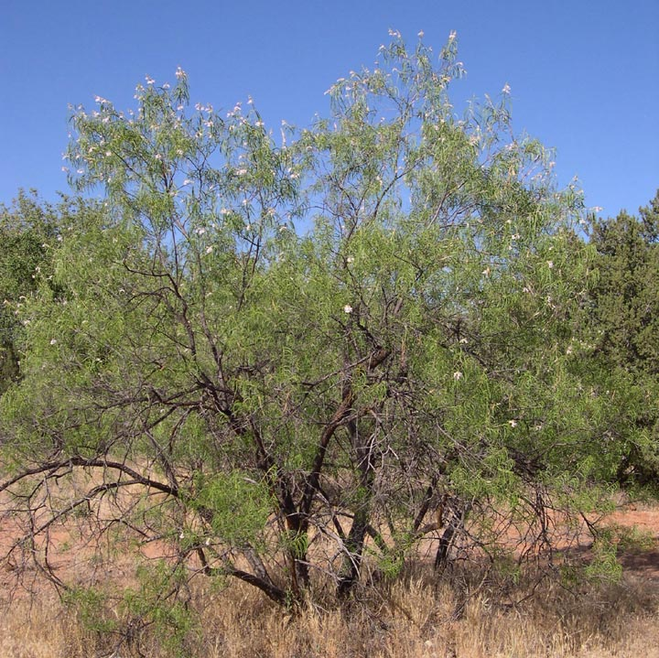
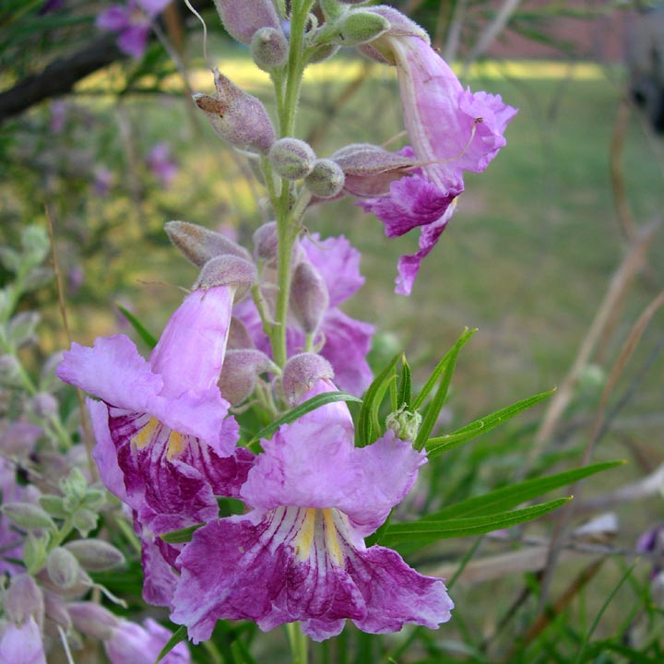
Desert willow Chilopsis linearis

Slide 15
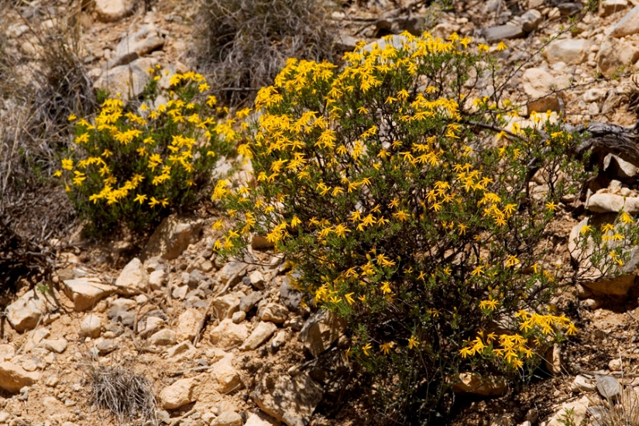
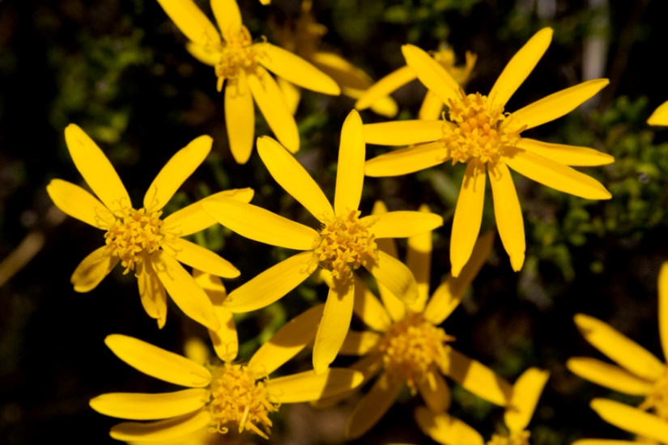
Damianita daisy Chrysactinia mexicana

Slide 16
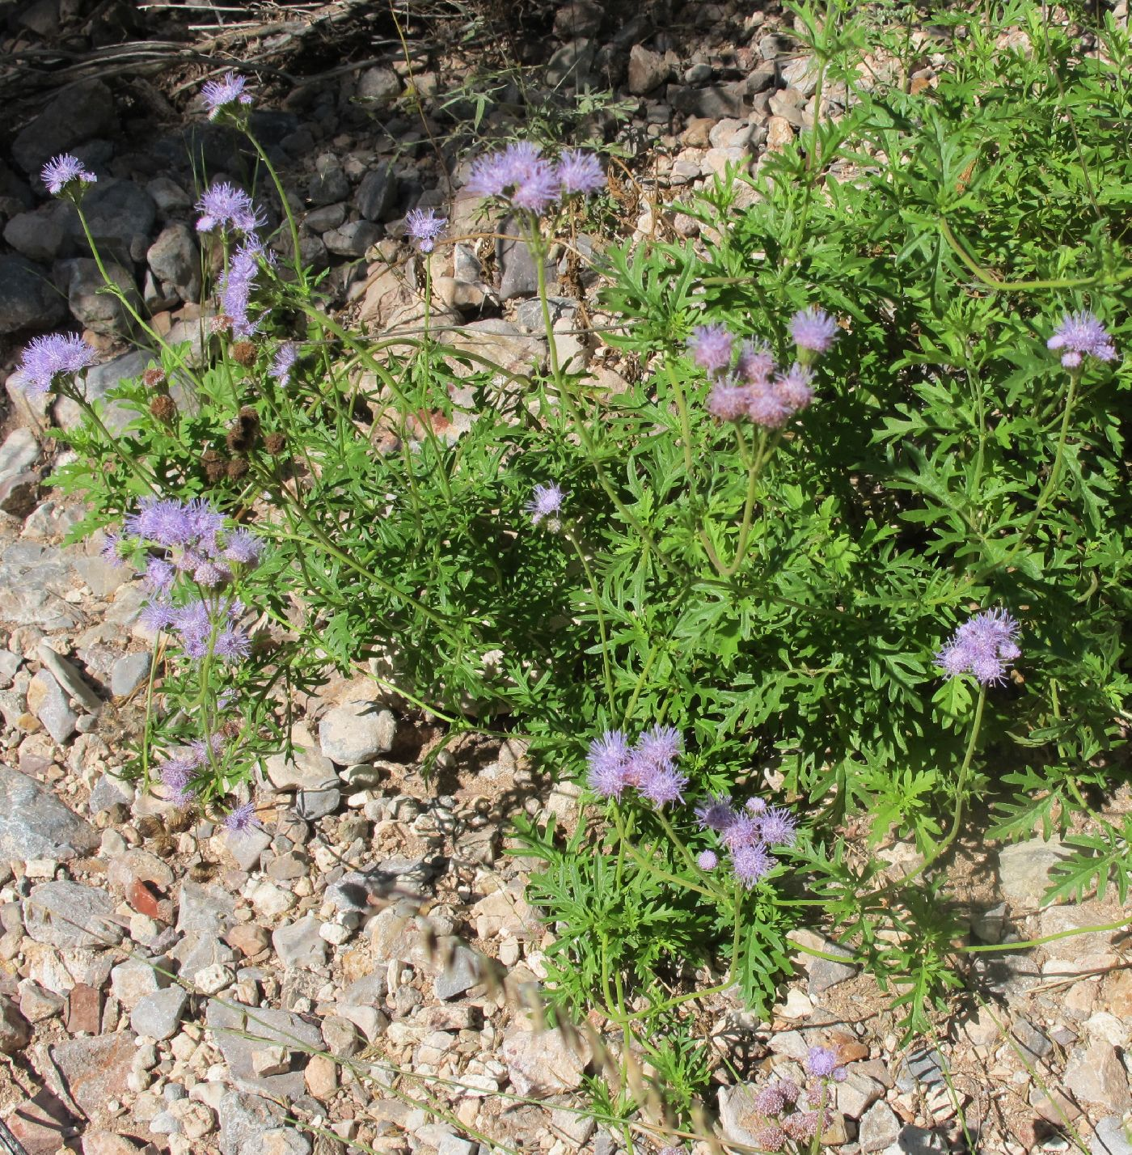
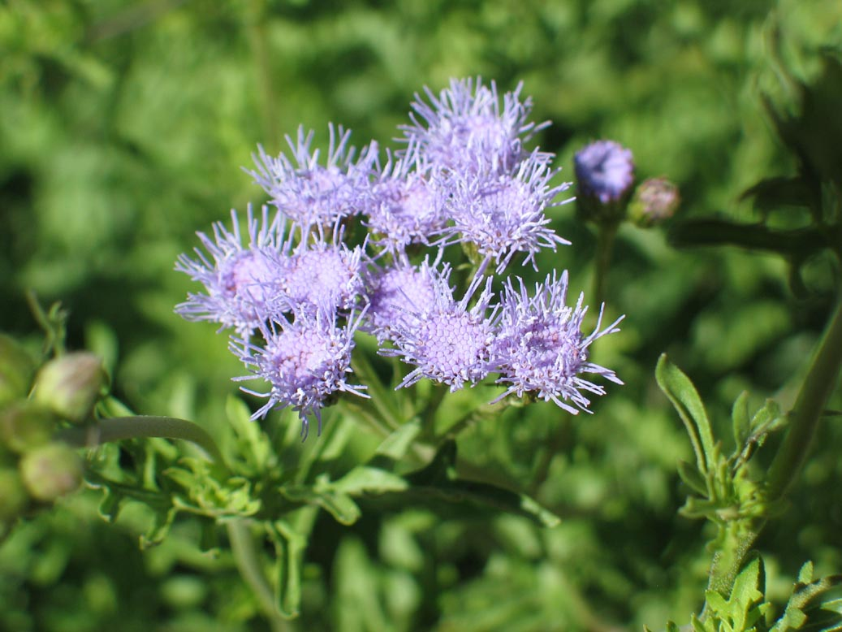
Gregg’s mistflower Conoclinium greggii

Slide 17
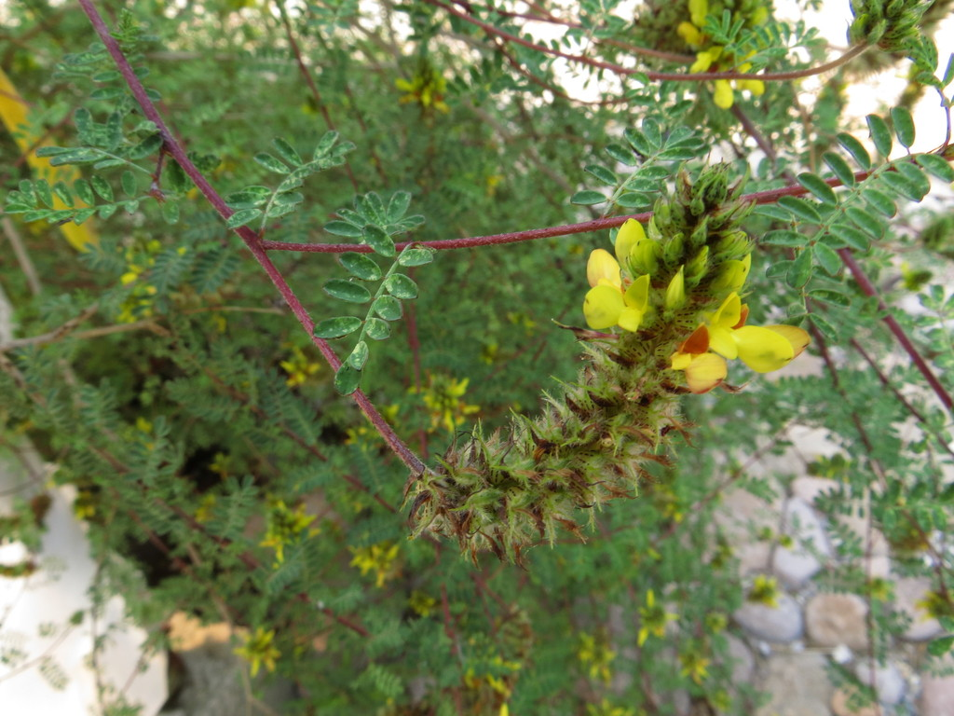
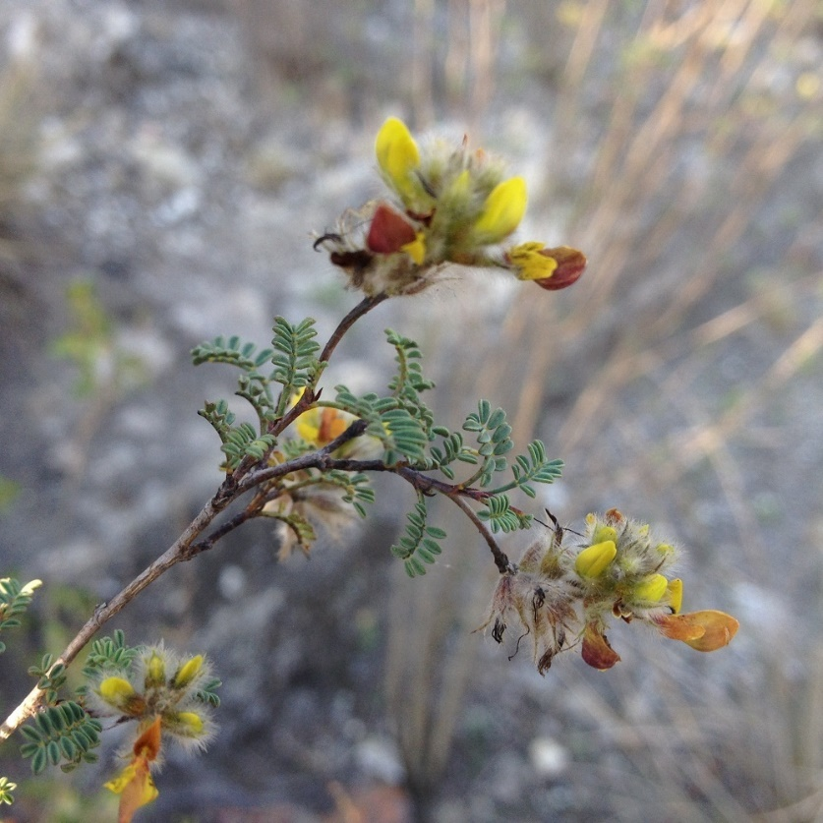
Yellow dalea Dalea lutea

Slide 18
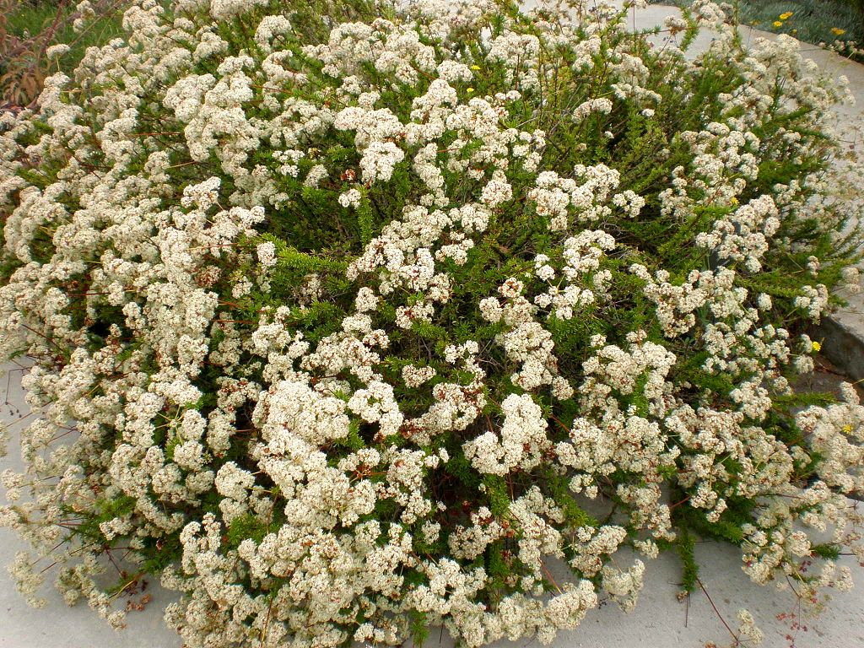
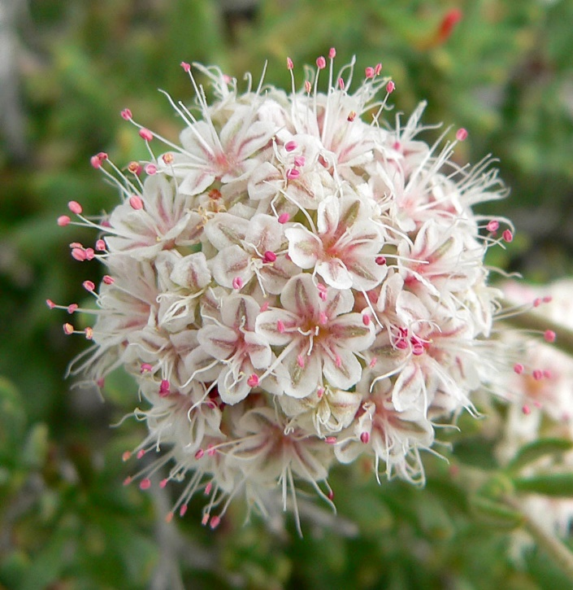
Eastern Mojave buckwheat Eriogonum fasciculatum

Slide 19
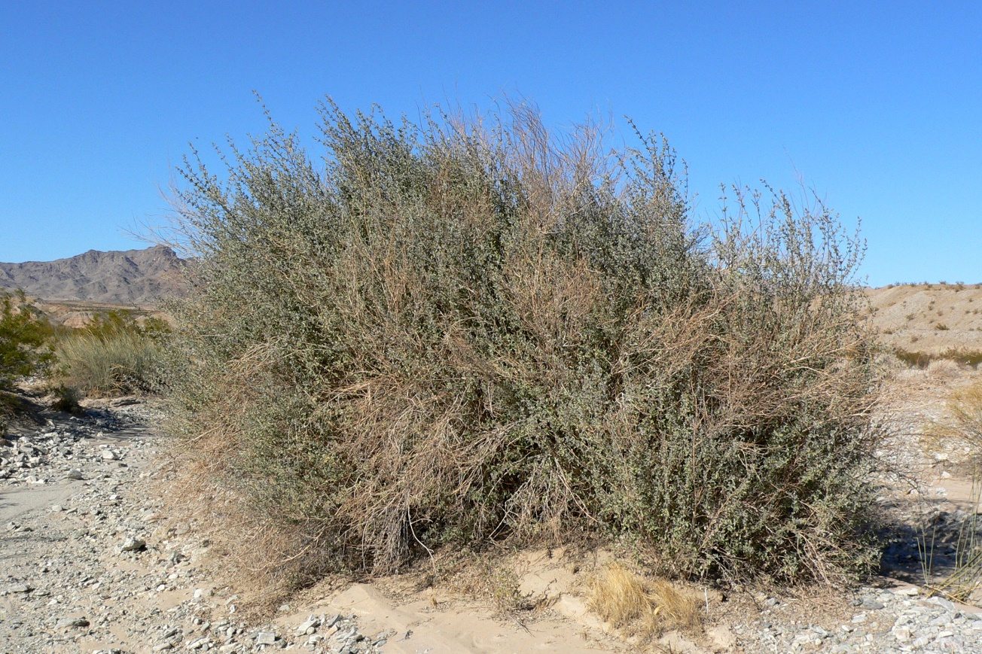
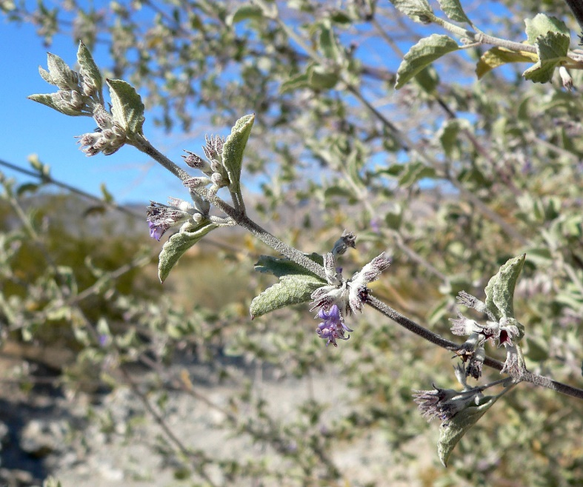
Desert lavender Hyptis emoryi

Slide 20
Winterfat Krascheninnikovia lanata

Slide 21
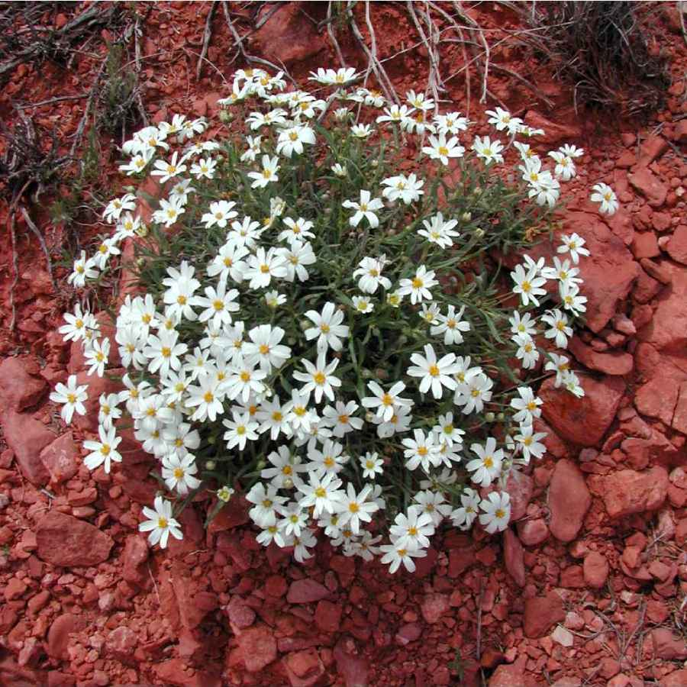
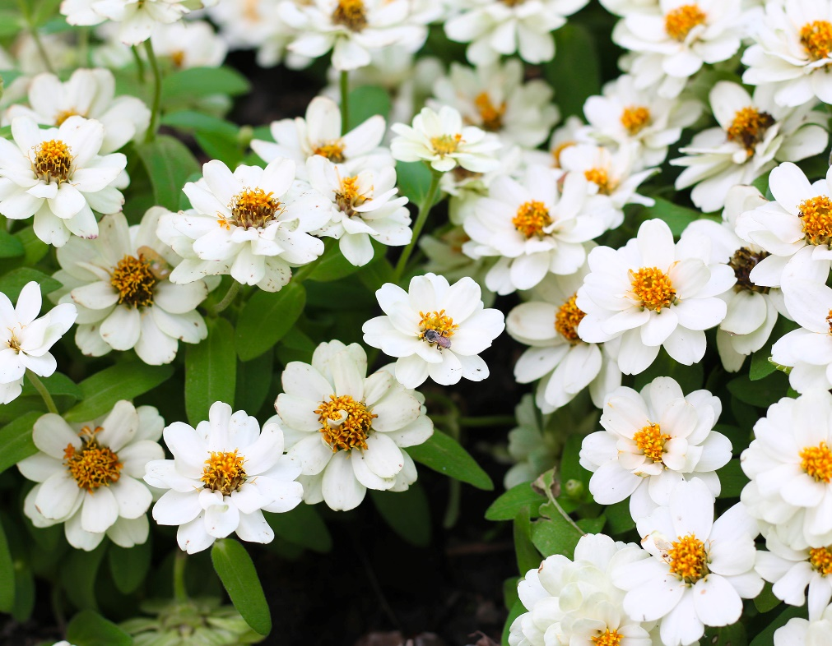
Blackfoot daisy Melampodium leucanthum

Slide 22
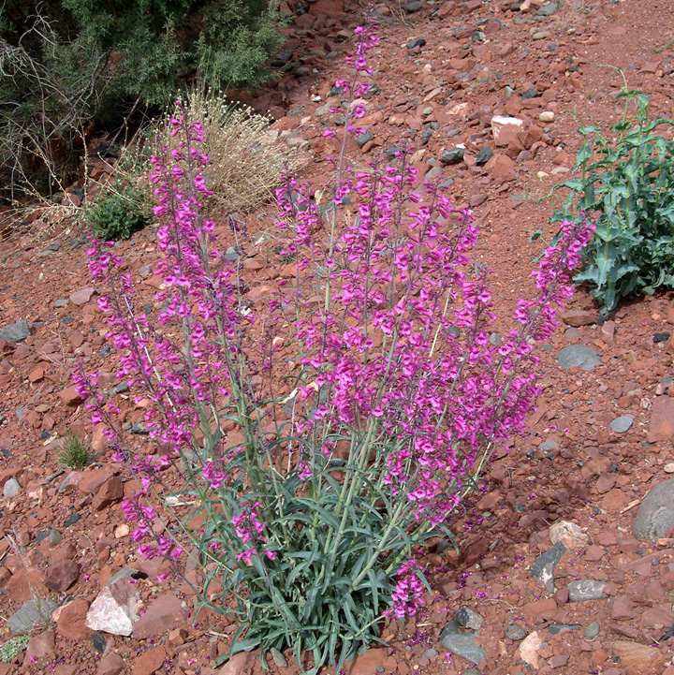
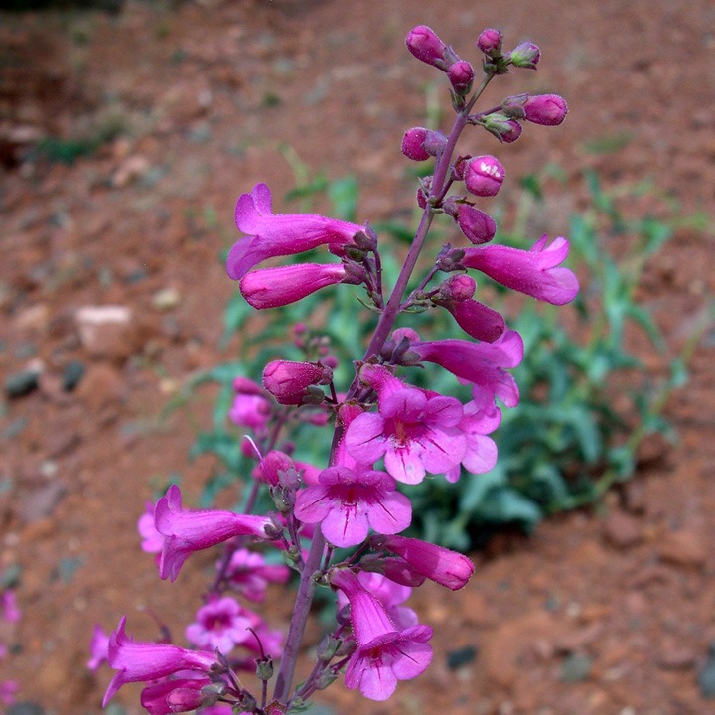
Penstemon Penstemon spp.

Slide 23
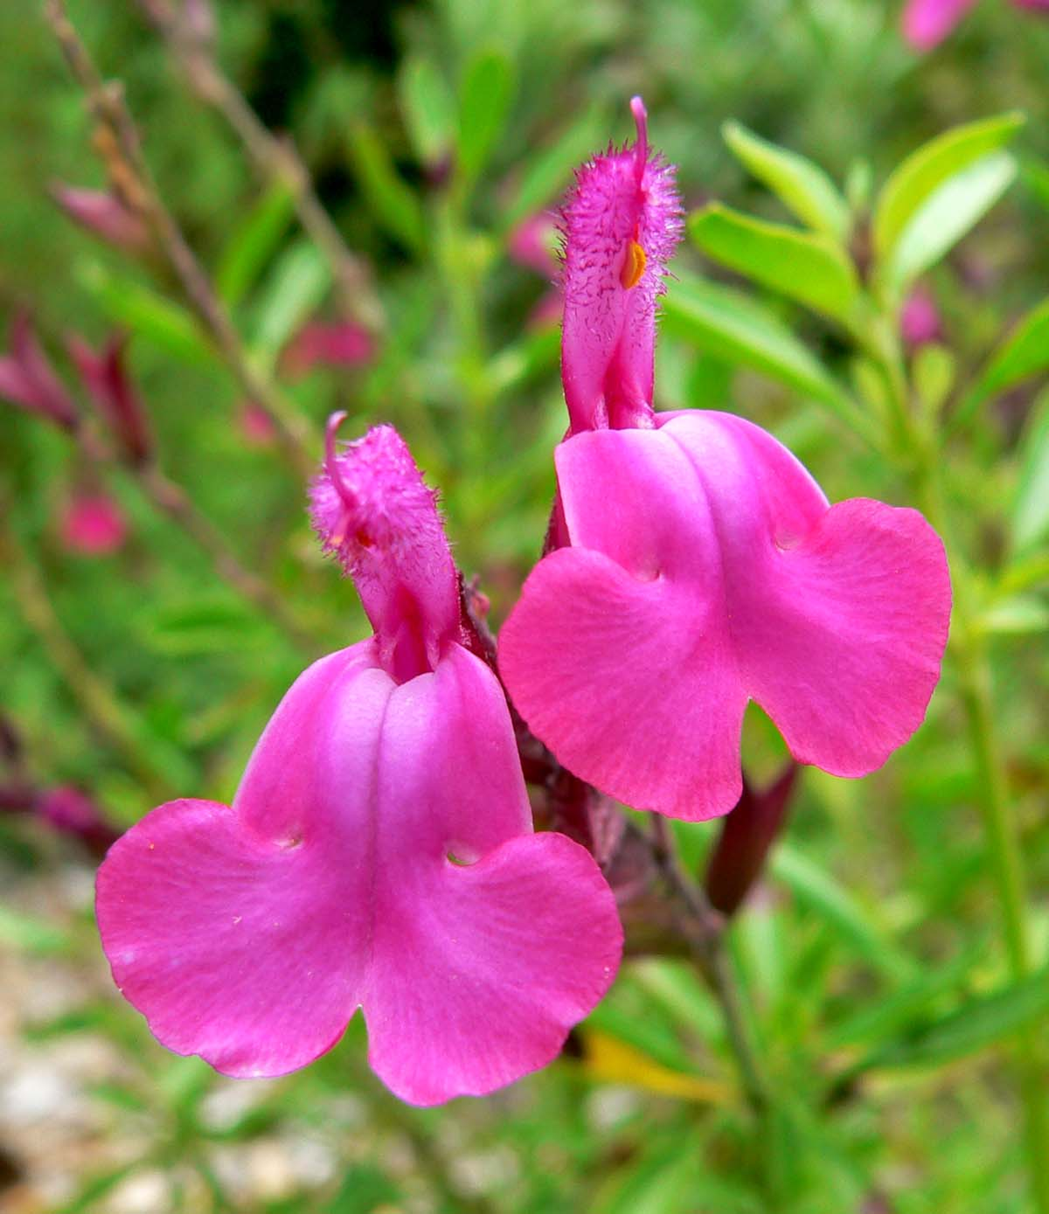
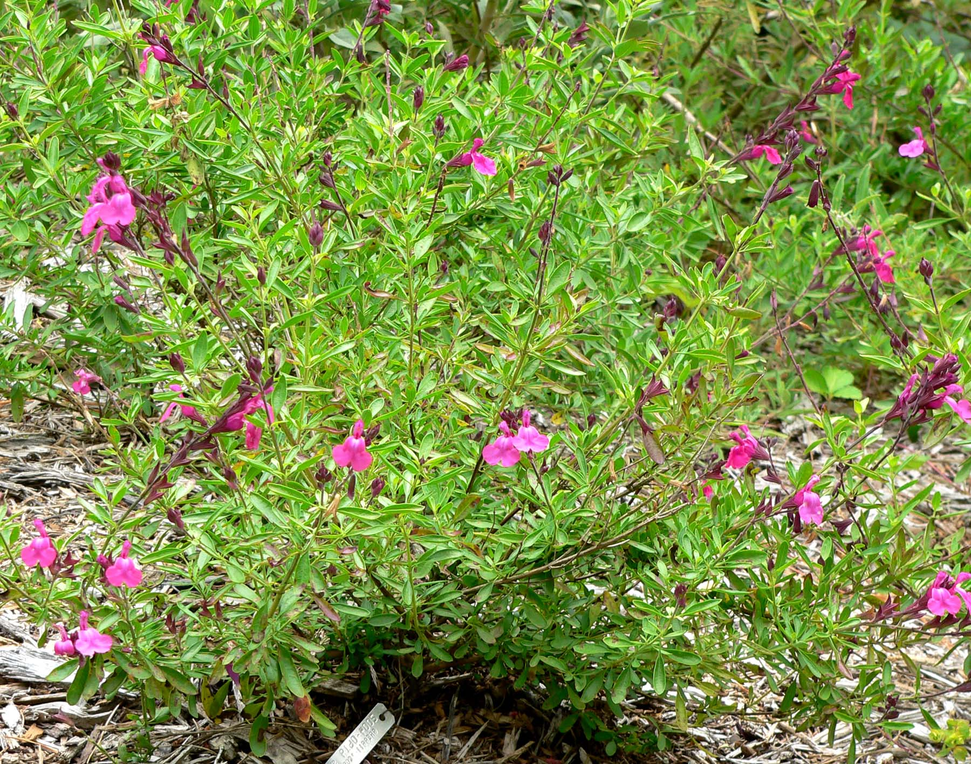
Autumn sage Salvia greggii

Slide 24
Mount Lemmon Marigold Tagetes lemmonii

Slide 25
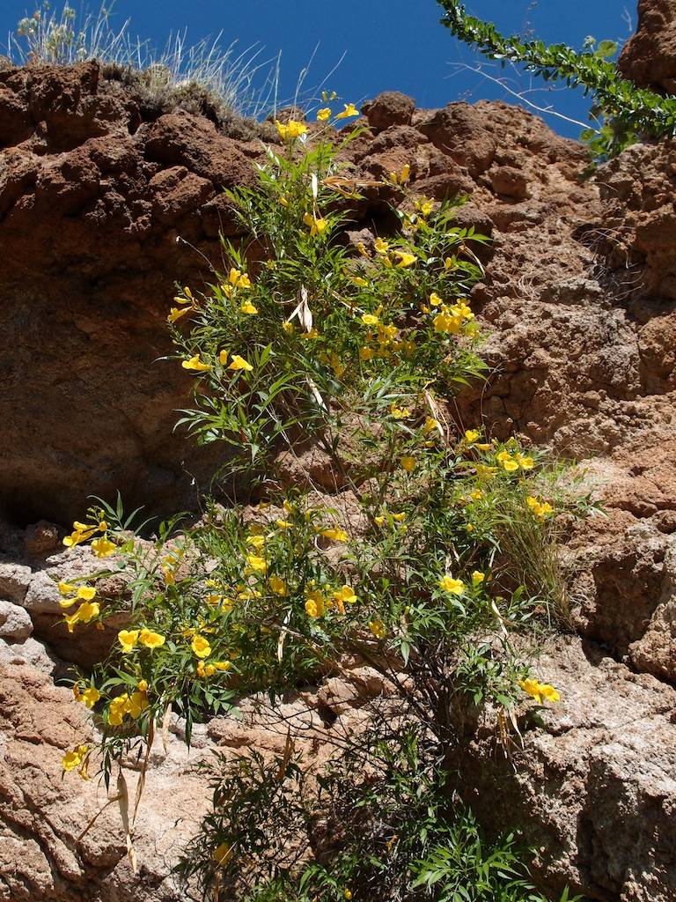
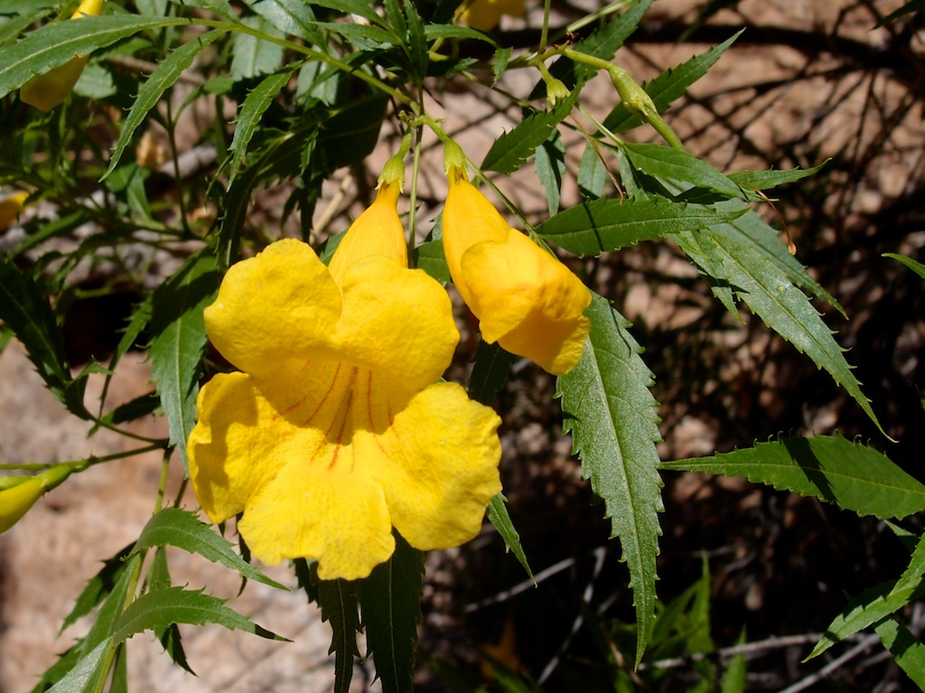
Yellow trumpet bush Tecoma stans

Slide 26
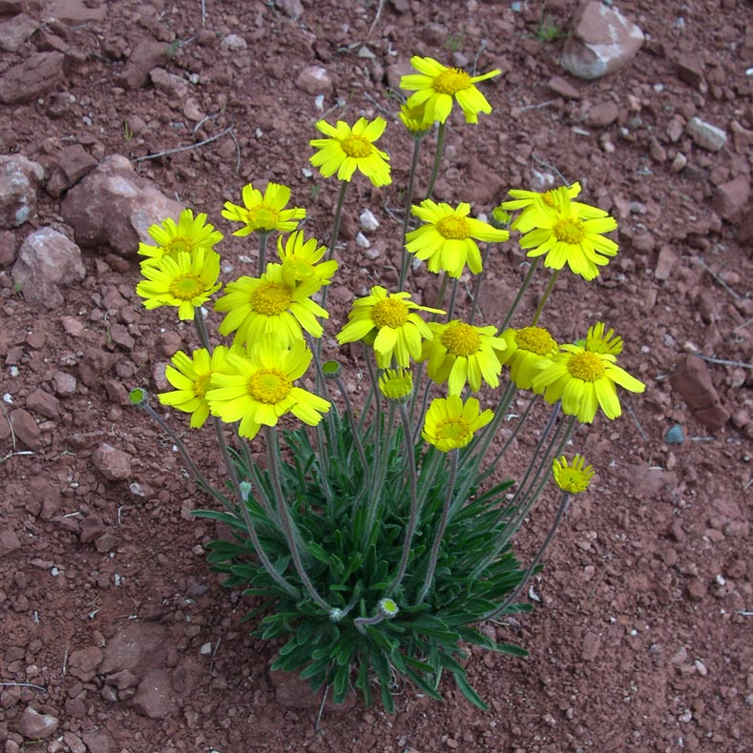
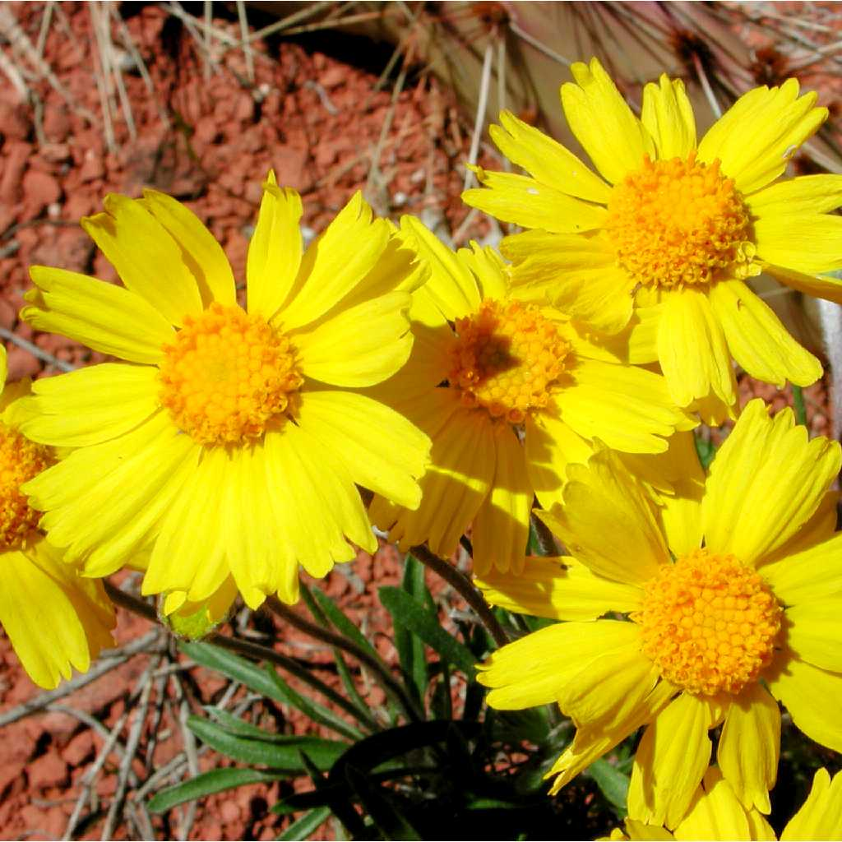
Angelita daisy Tetraneuris acaulis

Slide 27
Educational Resources
Check out the Monarch Joint Venture website for a number of educational resources. Links to information about funding for school gardens, curricula, and case studies can be found here: https://monarchjointventure.org/get-involved/i-am-a/educator

